Slide 1
SAP HANA 2.0 Database Administration Tasks

Slide 2
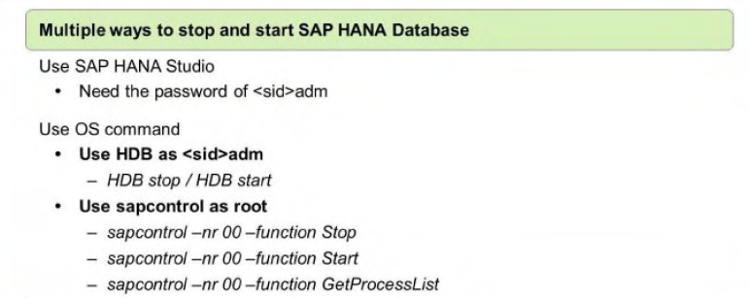
Starting and stopping the SAP HANA database
To be able to start and stop an SAP HANA system, you must have the credentials of the operating system user ( <sid>adm) that was created when the system was installed. Alternatively, SAP HANA can be started and stopped by root users. The SAP start service (sapstartsrv) is the standard SAP mechanism for starting and stopping systems. It starts all necessary database services. such as the name server, index server. and statistics server services.
The SAP HANA database can be started or stopped by using SAP HANA studio or by using OS commands.
When starting the SAP HANA database with the SAP HANA studio. you have to enter the user
name and password of the operating system user <sid>adrn.
Optionally. a start timeout can be specified. The start timeout defines how long sapstartsrv
waits for a service to start. If the end of the timeout period is reached. the remaining services are not started.

Slide 3
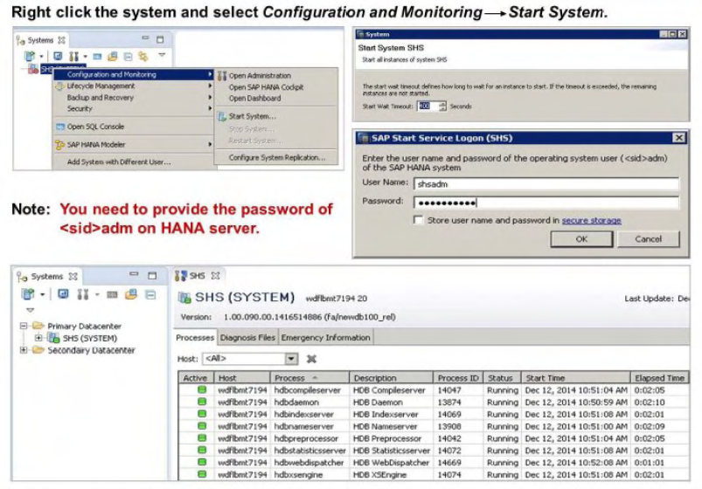
Starting the SAP HANA Database - Using HANA Studio
The Administration Editor opens in diagnosis mode and the database services start one by one. When all services have started. a green dot appears in the system icon in the Navigator view.
When the system is started. the following activities are executed:
• The database receives the status of the last committed transaction.
• All of the changes of committed transactions that were not written to the data area are redone.
• All of the write transactions that were open when the database was stopped are rolled back.
• Row tables are loaded into memory, except those tables that are configured to be loaded
on demand and that are not marked for preload.
• A savepoint is performed with the restored consistent state of the database.
• Relevant column tables and their attributes are loaded into memory asynchronously, in the
background.

Slide 4
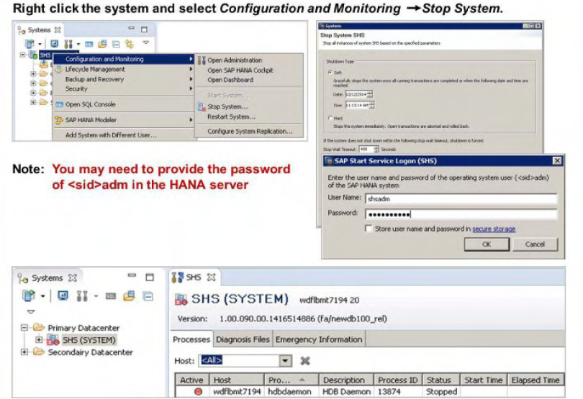
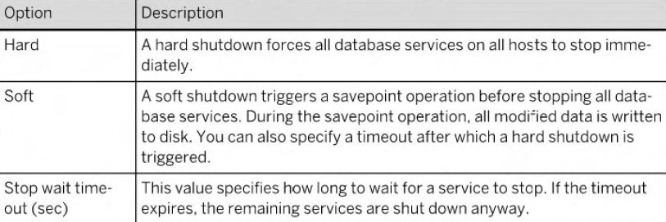
Stopping the SAP HANA Database - Using HANA Studio
When stopping the SAP HANA database, you are able to define how you want to stop the system.

Slide 5
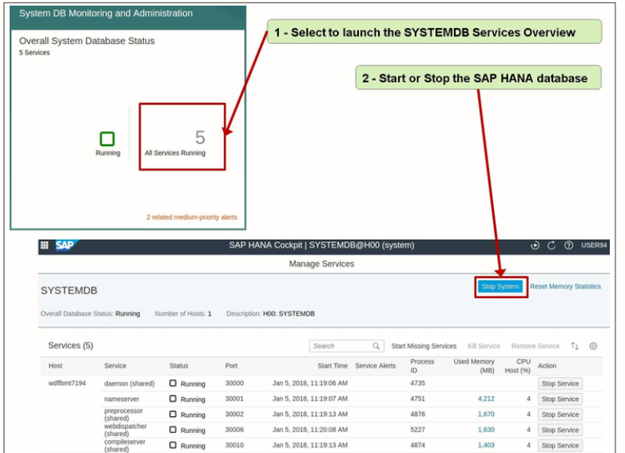
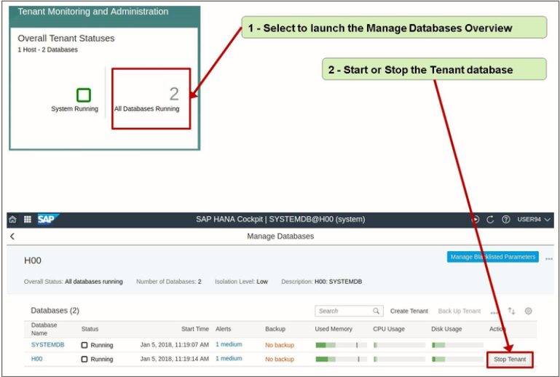
Starting the SAP HANA Database - Using HANA Cockpit

Slide 6
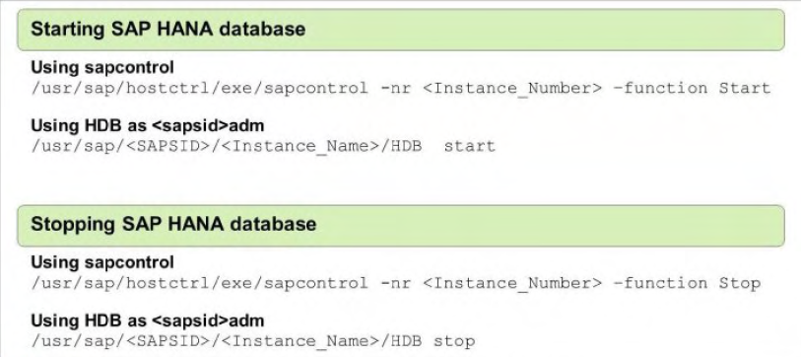
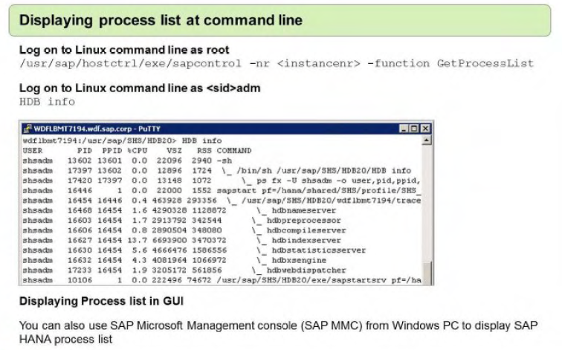
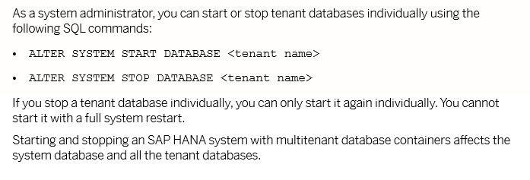
Starting and Stopping the SAP HANA Database - Using OS Commands

Slide 7
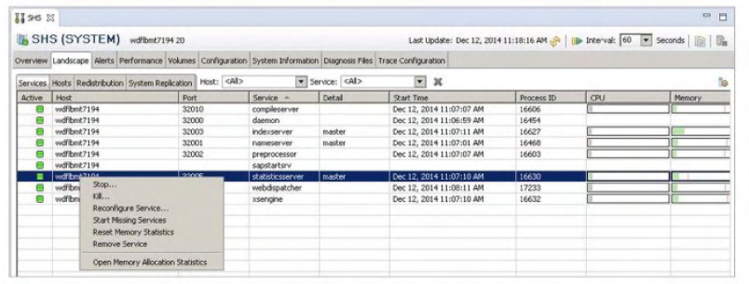
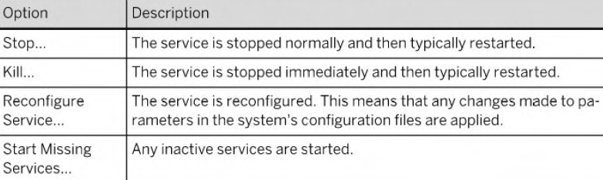
Stopping and Starting Individual Database Services
You can stop and start the individual database services (nameserver, indexserver, statisticsserver, xsengine. and so on) running on hosts.
To stop and start or restart database services. you must have the system privilege SERVICE ADMIN.
Examples of situations where you have to restart an individual database service are.
For example:
• A host in a distributed system failed and a standby host took over. However. the services of the failed host remain inactive even after the host is reachable again. In this case. you
need to restart the services manually.
• After an update of SAP HANA Extended Application Services (SAP HANA XS). The xsengine service needs to be restarted.

Slide 8
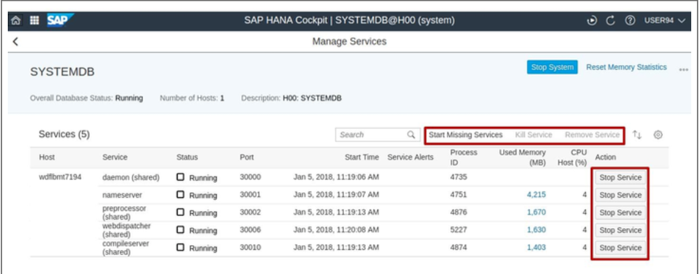
Stopping and Starting Individual Database Services in Cockpit

Slide 9
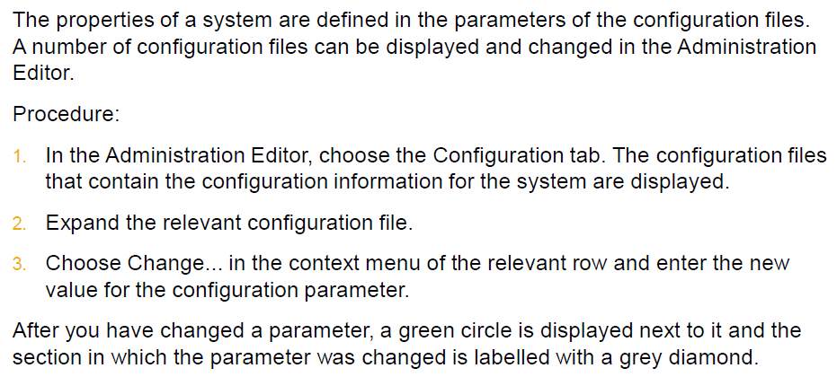
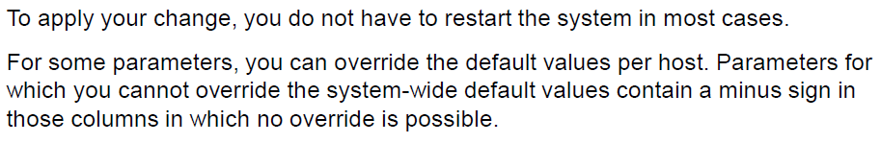
Configuration Changing Parameter Values
To delete a user-defined value and restore the default value, you can choose one of
the following methods:
Delete with automatic reset:
1. In the context menu of the configuration parameter, choose Delete.
2. Choose the layer whose user-defined values you want to delete and Choose
Delete.
Note: If you added a new parameter to a section, then choosing Delete from the
context menu deletes the entire parameter.
Manually restore default:
1. In the context menu of the configuration parameter, choose Change...
2. For the required layers, choose Restore Default, or if you want to reset all visible
layers, choose Restore Default for All. Choose Save.

Slide 10
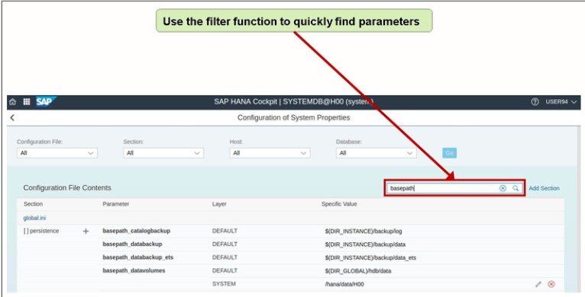
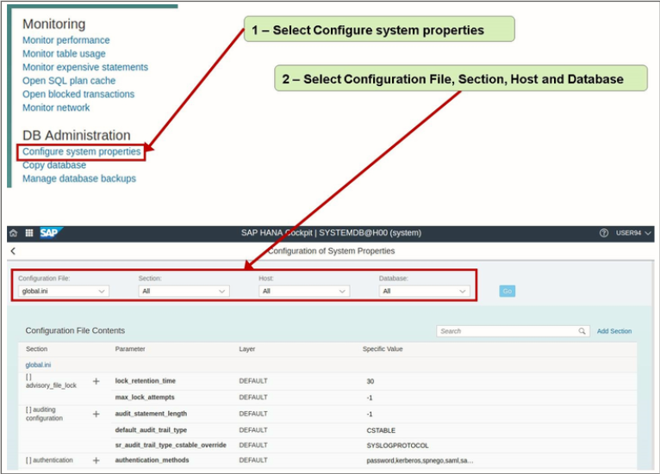
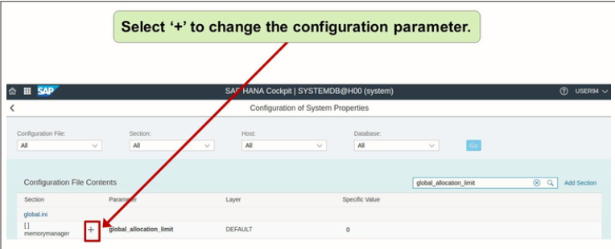
Using SAP HANA Cockpit

Slide 11
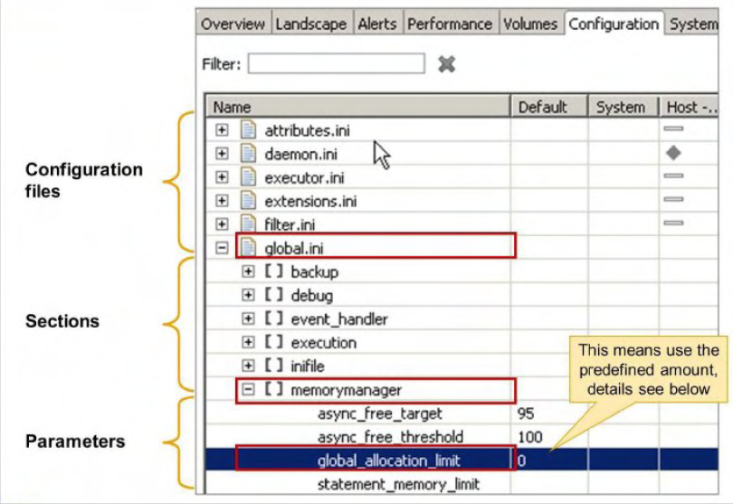
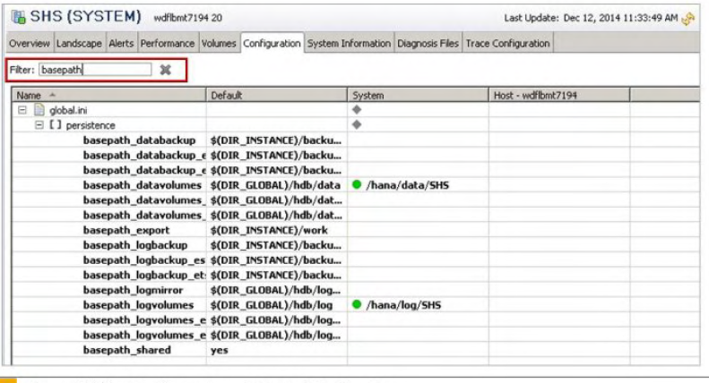
Using SAP HANA Studio
The configuration files are located in the following directories:
• /usr/sap/<sid>/SYS/global/hdb/custom/config
• /usr/sap/<sid>/HDB/<instance number>/<server name>
Configuration files (.ini files) are only created in the above directories if customer specific changes are made to them after installation. If no customer-specific changes have been made, these directories may be empty.

Slide 12
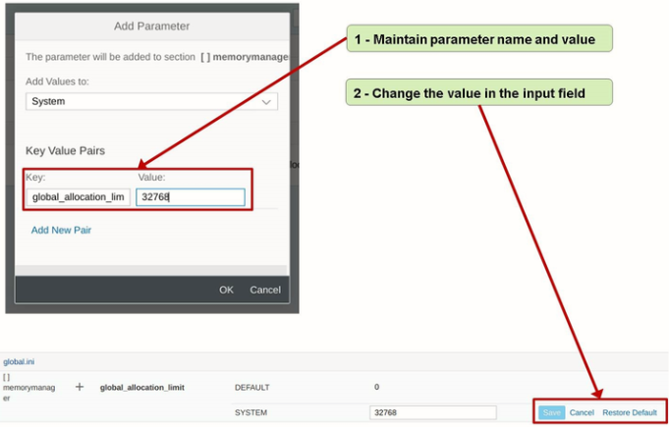
Change Memory Parameter

Slide 13
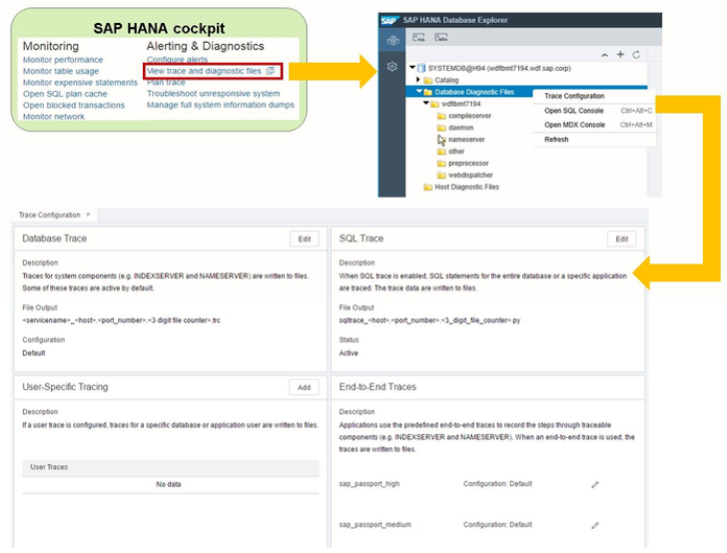
Configuring Traces

Slide 14
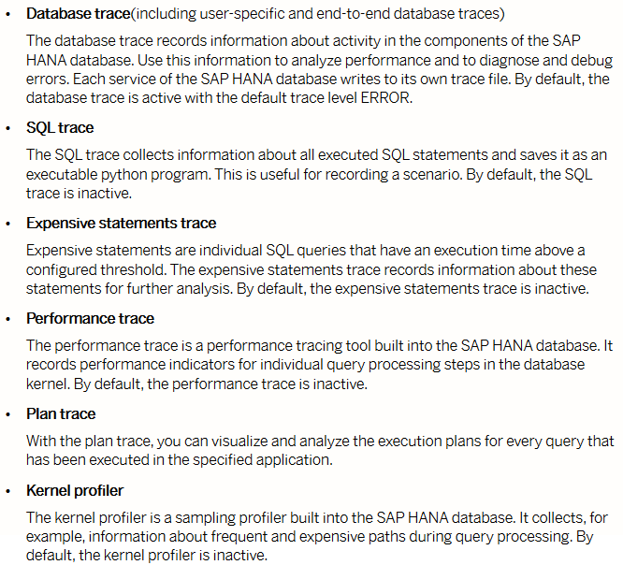
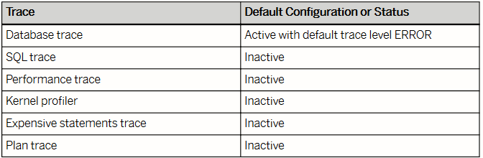
Traces
To configure trace, system privilege
TRACE ADMIN is required.
To configure kernel profiler, standard role
SAP_HANA_INTERNAL_SUPPORT is required.

Slide 15
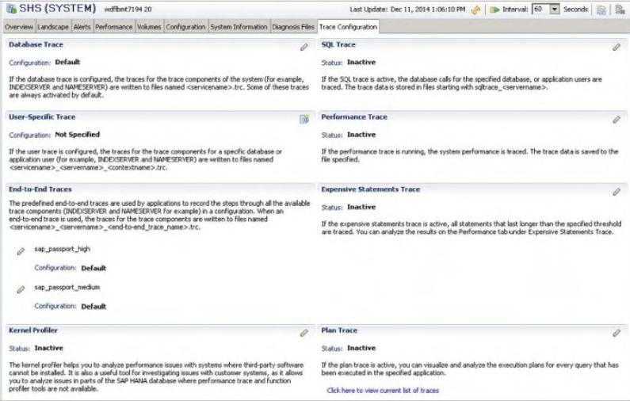
Configuring Traces from HANA Studio
To be able to configure traces. you must have the system privilege TRACE ADMIN.
To configure the kernel profiler. you must have the SAP INTERNAL_HANA_SUPPORT standard role.

Slide 16
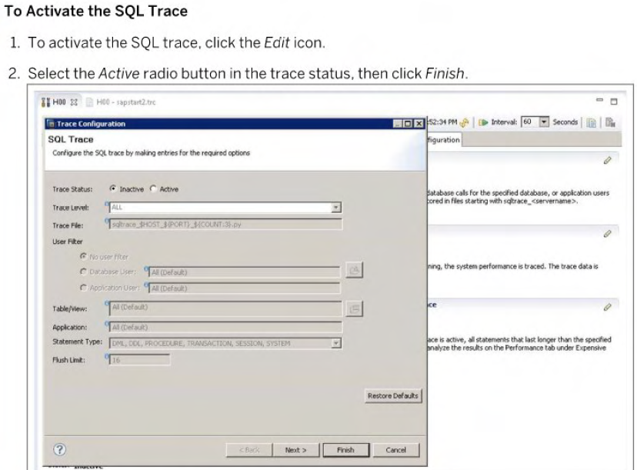
Activate trace
Database trace is activated by default.
Check the Diagnosis Files
In case of problems with the database. log and trace files can be checked for errors. These
diagnosis files are available in the studio on the Diagnosis Files tab of the Administration
editor. For more information. refer to the section Working with Diagnosis Files in this unit.
To display a diagnosis file. choose Open in the context menu of the list. or double-click the
entry of the respective log file.

Slide 17
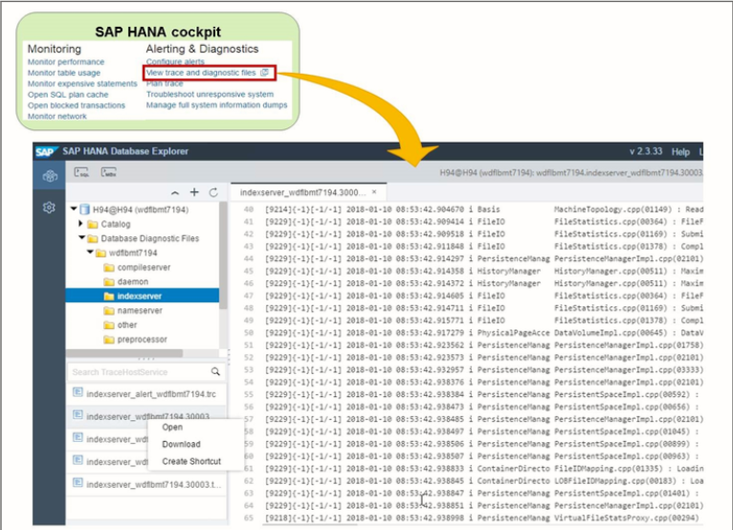
Working with Diagnosis files
Diagnosis files include log and trace files. as well as a mixture of other diagnosis, error. And information files. In the event of problems with the SAP HANA database. you can check these diagnosis files for errors. You can also filter. merge, delete. and download diagnosis files.
You can access the diagnosis files on the Diagnosis Files tab of the Administration editor.
They are stored by default in the following location: /usr /sap/ <SID>/HDB<instance>/<host>/trace
In this location you can monitor disk space that is used for diagnosis files and delete files that are no longer needed.
To be able to view diagnosis files and delete trace files. you must have the system privilege TRACE ADMIN.

Slide 18
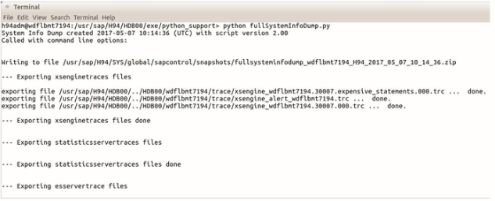
Collecting and Downloading Diagnosis Information
To analyse and diagnose problems with the system, you can collect diagnosis information into a zip file. which you can then download and attach to a support message. The script was extended to include the following:
• Collect diagnosis information through the execution of a SQL procedure.
• Collect diagnosis information through the execution of a Python script.
• Download and delete collected diagnosis information
When you trigger the collection of diagnosis information. the system collects the relevant information by executing the Python script FULLSYSTEMINFODUMP. PY.
You can execute this script either using an SQL procedure or directly, if no SQL connection is available to the database. Even if an SQL connection is available. it may be desirable to
execute the Python script directly if using the
SQL procedure would overload the system.
Collecting Diagnosis Information Using the
Command Line

Slide 19
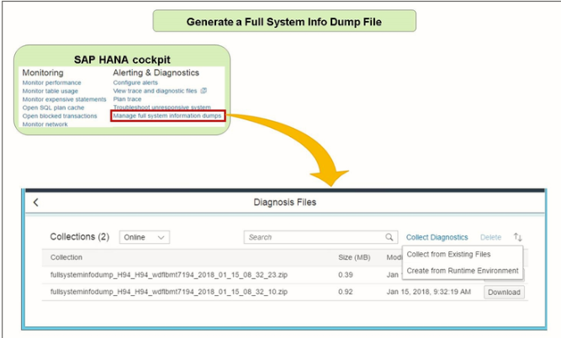
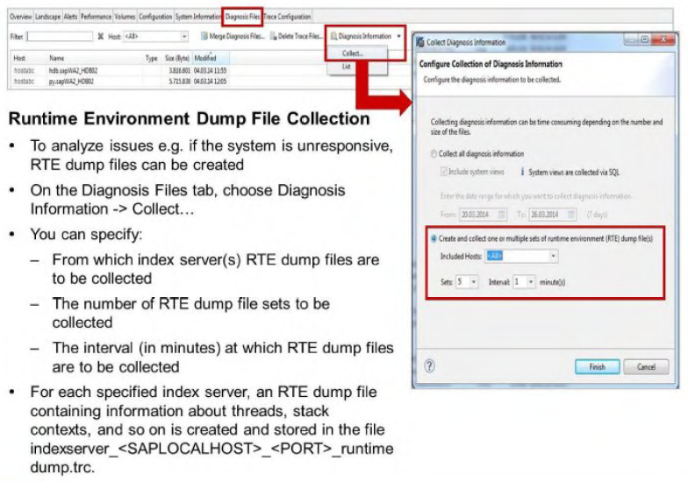
Dump File Collection

Slide 20
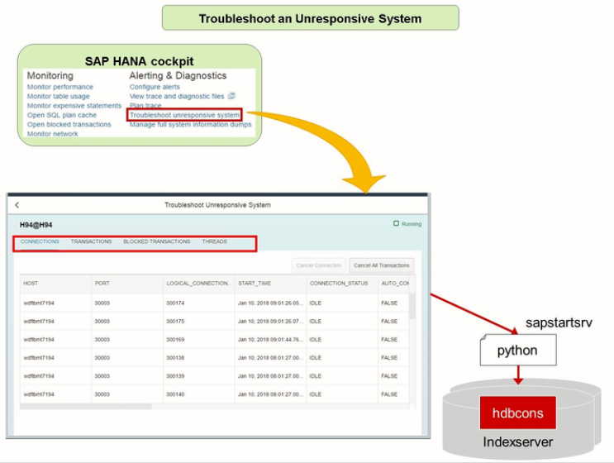
Troubleshoot using HANA Cockpit

Slide 21
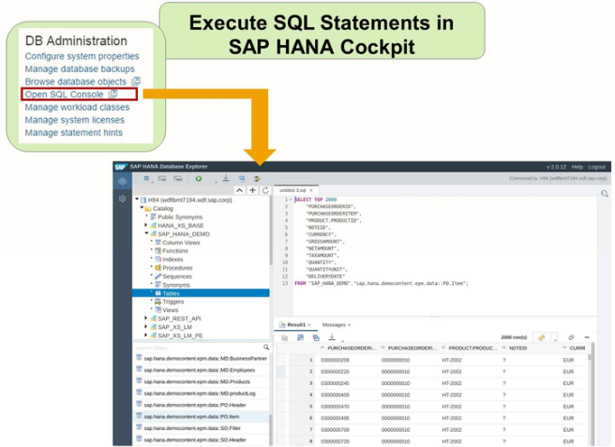
Using the SQL Console

Slide 22
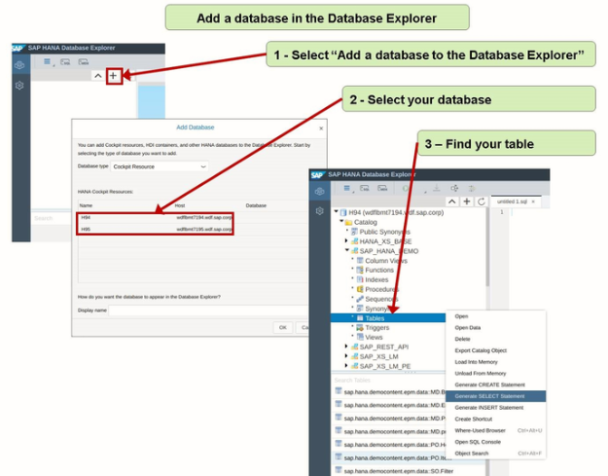
Add a database to the explorer

Slide 23
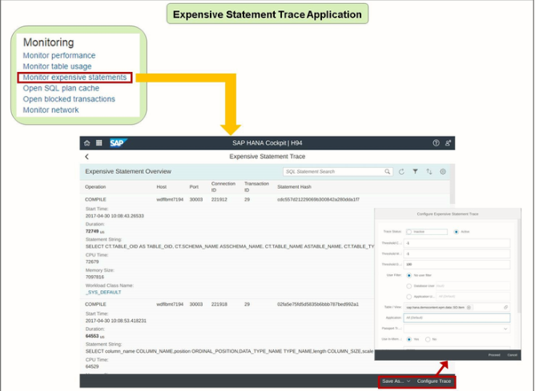
Monitor Expensive Statement Trace

Slide 24
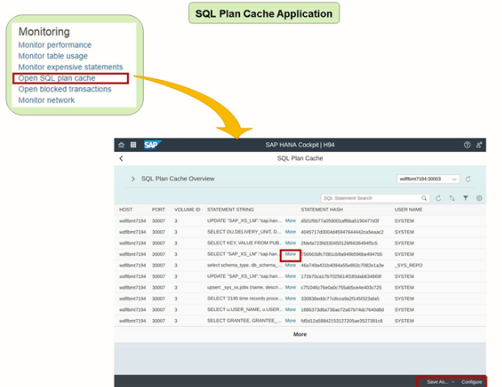
SQL Plan Cache

Slide 25
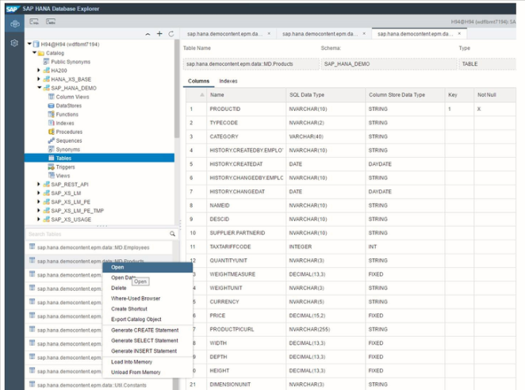
Table Definition in Database Explorer

Slide 26
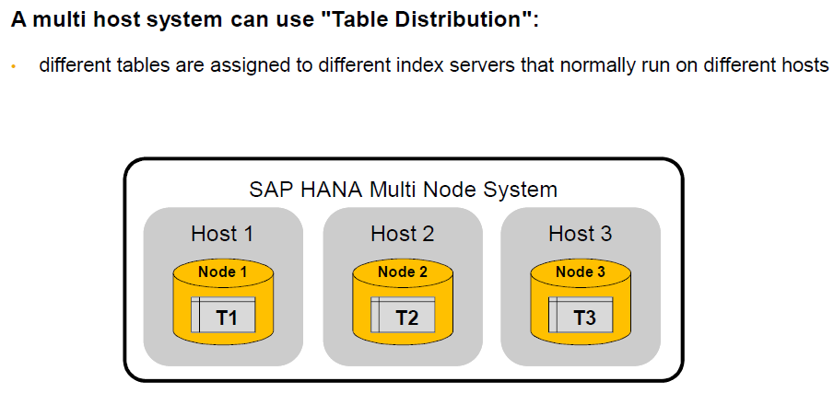
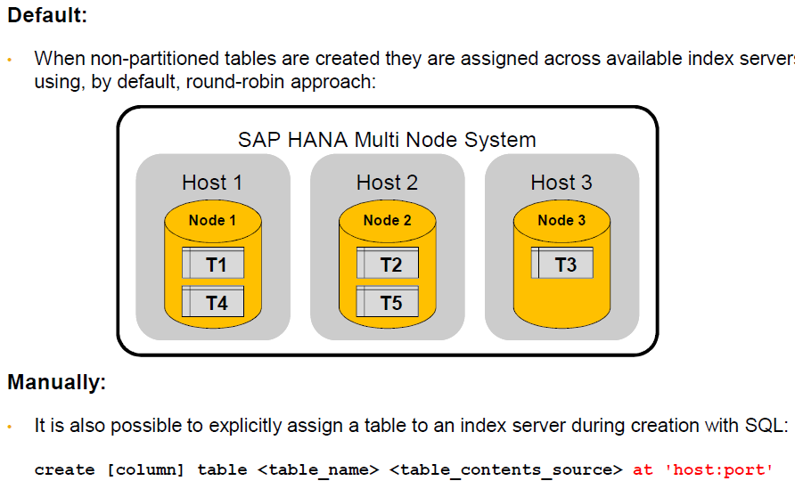
Table Distribution

Slide 27
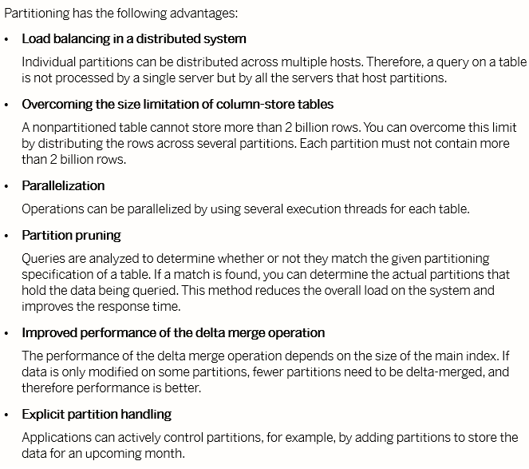
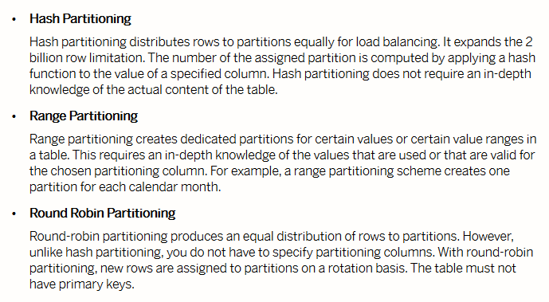
Table Partitioning

Slide 28
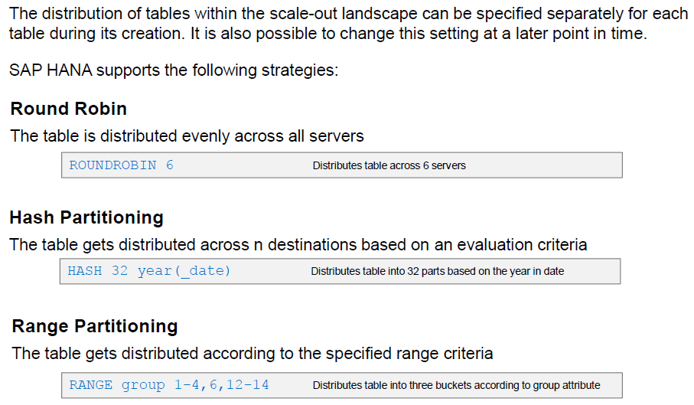
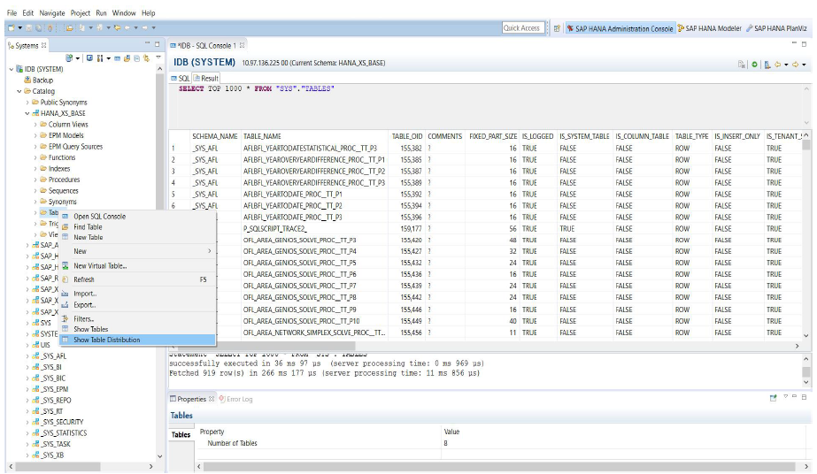
Table Partitioning

Slide 29
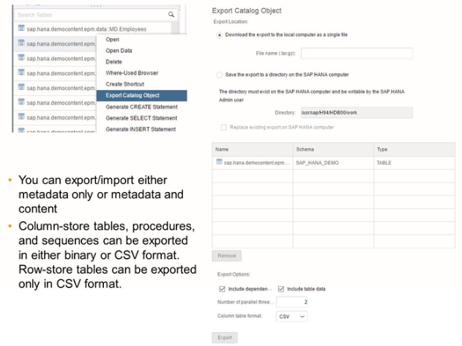
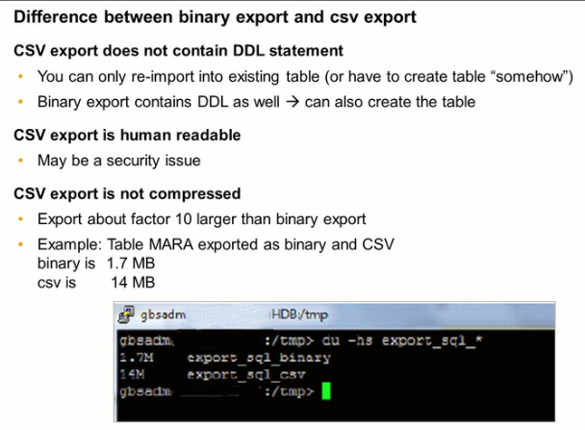
Importing and Exporting Tables

Slide 30
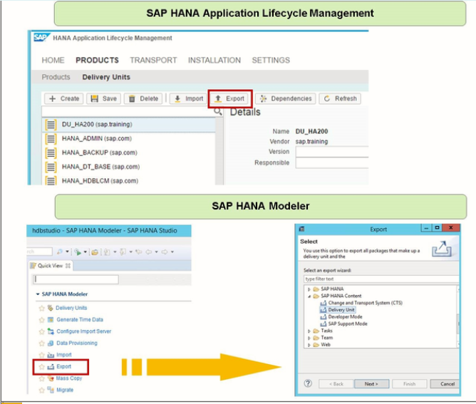
Export and Import of Models

Slide 31
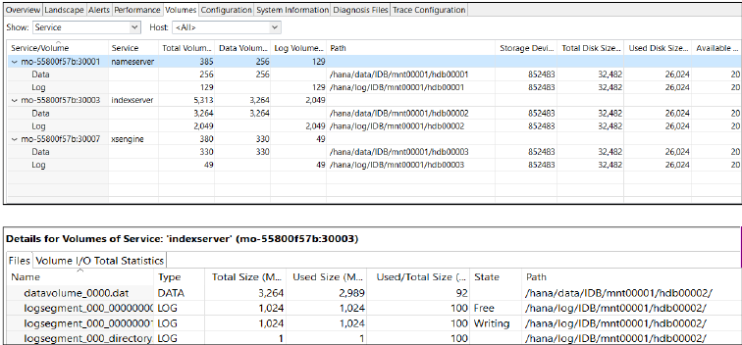
Monitoring Disk Space
Data files contain all the data in the database. Data is copied to the disk at
regular intervals in case of data loss as a result of a power failure. You must
always ensure that there is enough space on the disk for these files to be
saved. Data within a system is contained in volumes.
You can monitor disk space on the Volumes tab of the Administration Editor.
You can view volume information according
to the following filters:
The Show filter enables you to view the
volumes information either by service
or storage ID.
The Host filter enables you to view volumes
information either on all hosts or
on selected hosts.

Slide 32
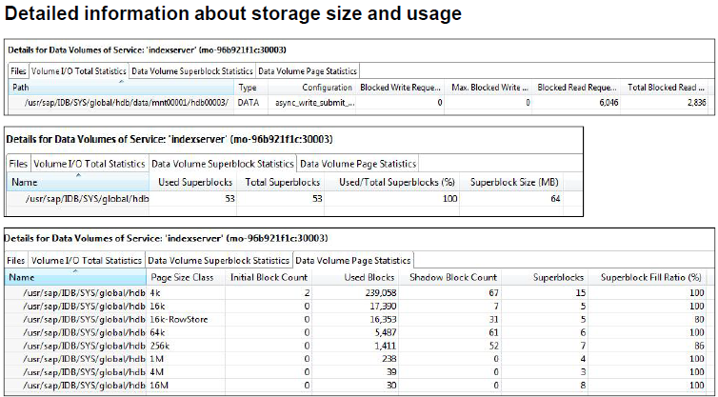
Volumes

Slide 33
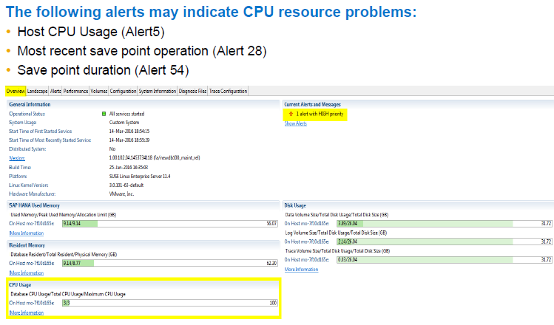
CPU

Slide 34
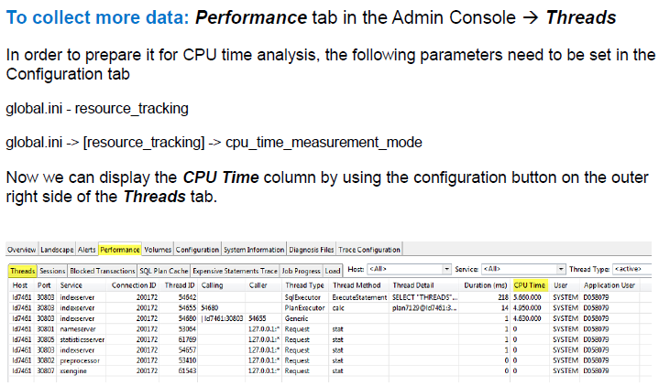

Slide 35
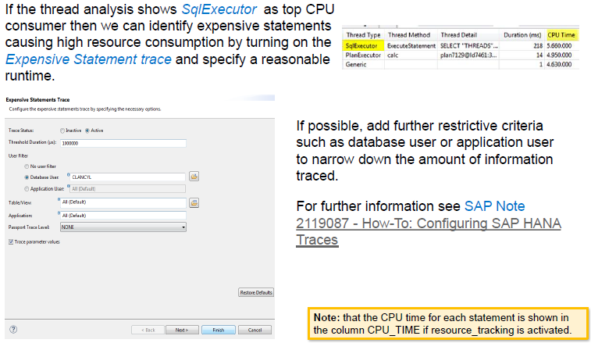

Slide 36
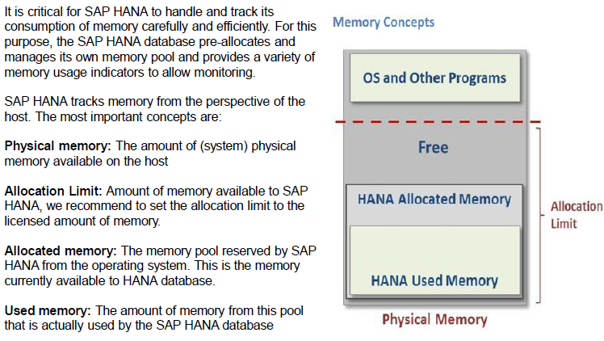
Memory

Slide 37


Slide 38

Global Allocation Limit Parameter

Slide 39

Monitoring in the SAP HANA cockpit

Slide 40


Slide 41


Slide 42


Slide 43


Slide 44
SAP HANA Alerts

Slide 45

Monitoring Alerts

Slide 46

Alerts in SAP HANA Cockpit

Slide 47

Alerts Configuration in Cockpit

Slide 48

Threads

Slide 49

Sessions

Slide 50

Monitor Statements

Slide 51

System Replication

Slide 52

General Information

Slide 53

Navigating Alerts from HANA Studio

Slide 54

Filtering Alerts

Slide 55

Detailed Alert Information

Slide 56


Configuring the E-mail function

